Slide 1

Trabalho Final
Dados GNSS via NTRIP e FTP
Aluno: Rogério Ramos Rodrigues do Carmo
Prof. Dr. Milton Hirokazu Shimabukuro
Disciplina: Técnicas de Programação
Aplicadas às Ciências Cartográficas
Programa de Pós Graduação em Ciências Cartográficas (PPGCC)

Slide 2
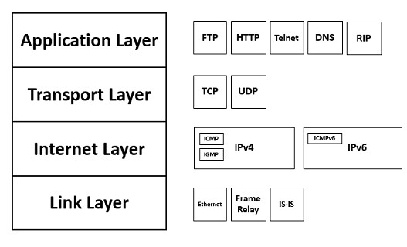
The TCP/IP Protocol Stack
https://www.comparitech.com/net-admin/ultimate-guide-tcp-ip/

Slide 3
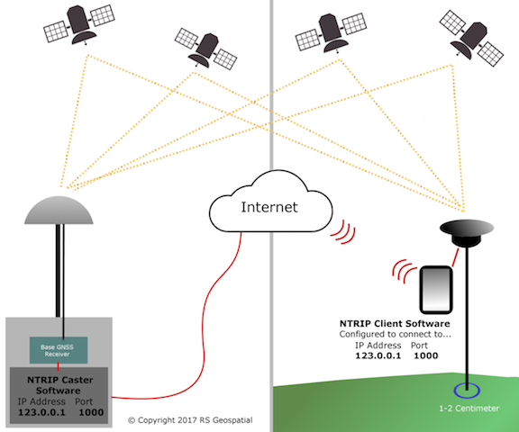
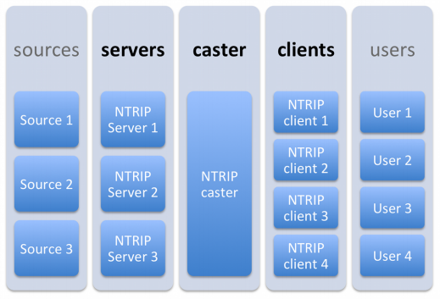
Networked Transport of RTCM via Internet Protocol (Ntrip)
https://www.agsgis.com/What-is-NTRIP_b_42.html
https://ieeexplore.ieee.org/stamp/stamp.jsp?arnumber=6831329

Slide 4
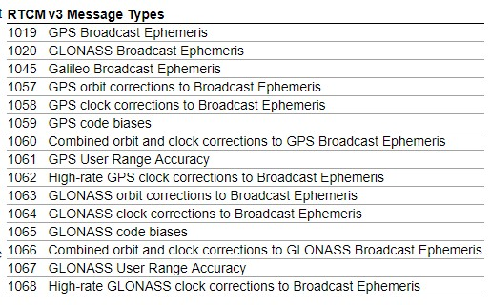
Radio Technical Commission for Maritime Services (RTCM)

Slide 5
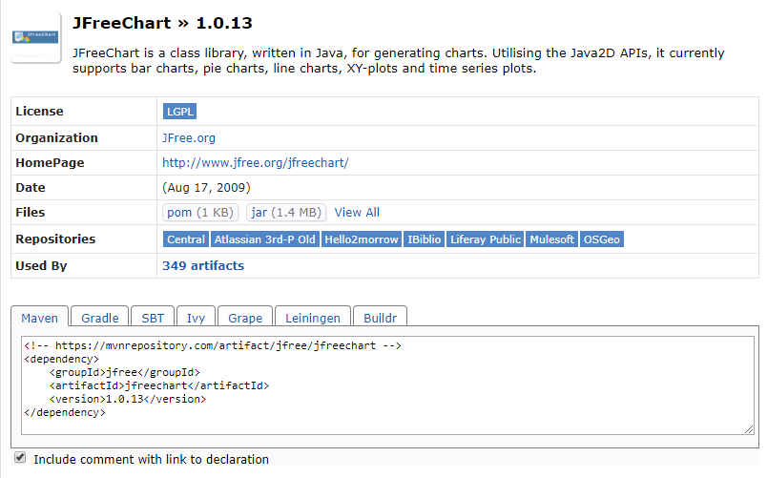
Maven build automation tool
https://mvnrepository.com/artifact/jfree/jfreechart/1.0.13

Slide 6
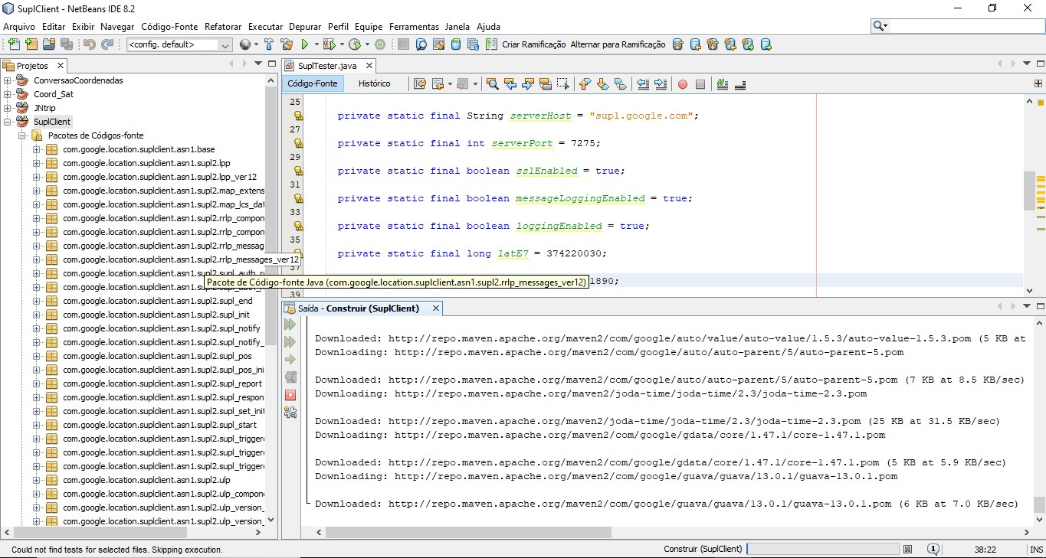
Maven build automation tool

Slide 7
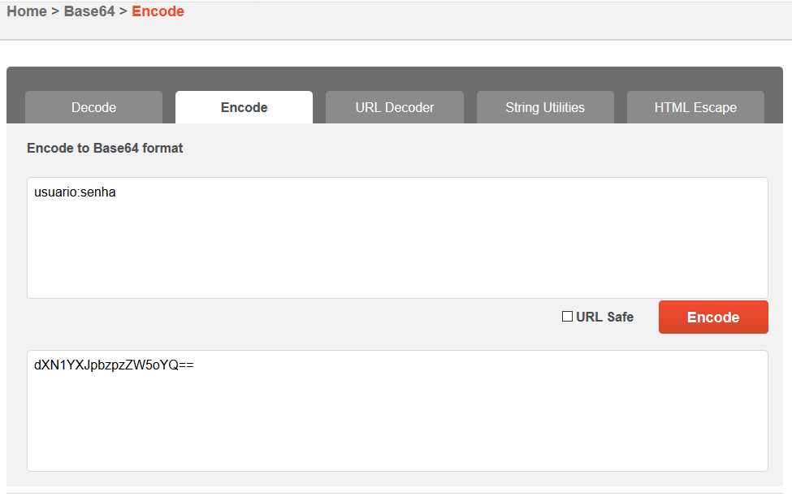
Base64 Convertion
To authenticate on Ntrip Caster
https://www.base64code.com/encode

Slide 8
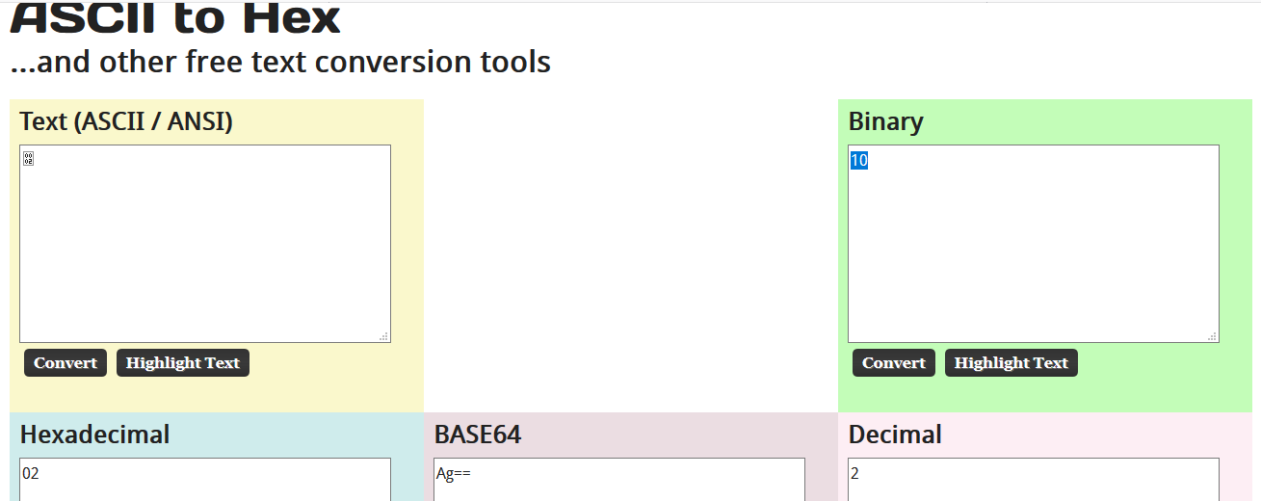
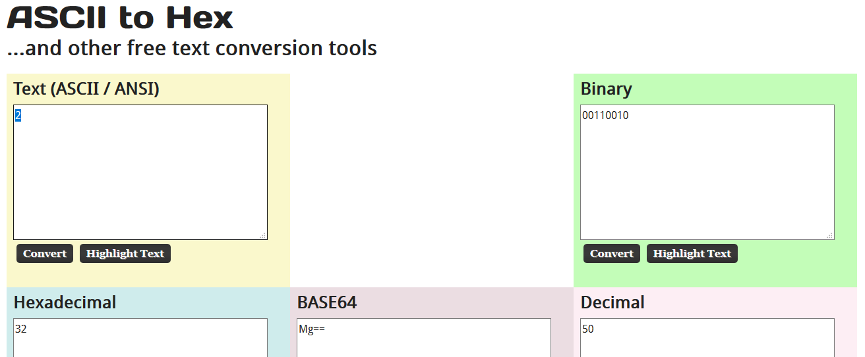
Convertions to read RTCM messages
https://www.asciitohex.com/

Slide 9
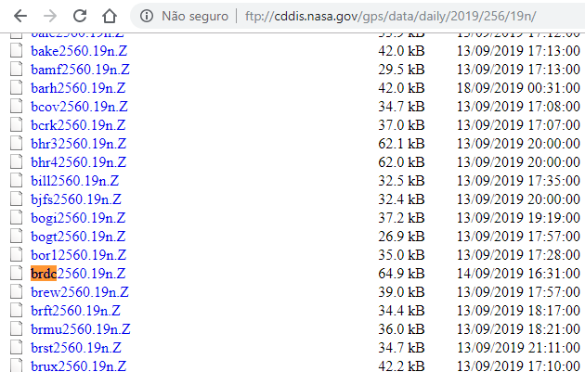
Broadcast Ephemeris

Slide 10
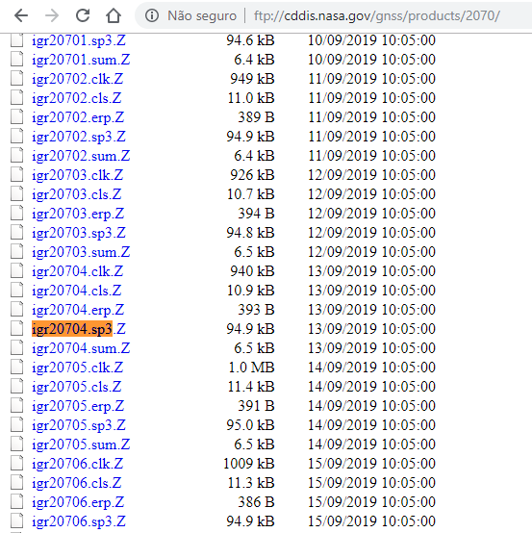
Precise Ephemeris

Slide 11
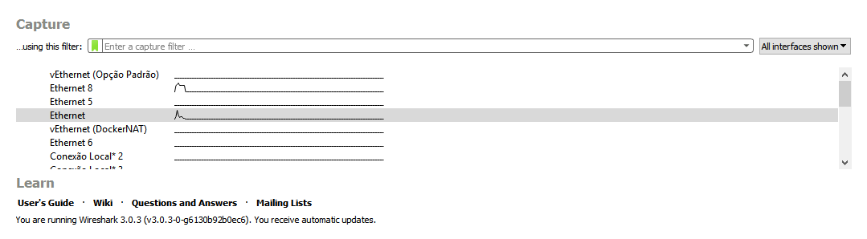
Wireshark software
Analyze packets sent/received through each Internet adapter

Slide 12
BKG Ntrip Client (BNC)

Slide 13
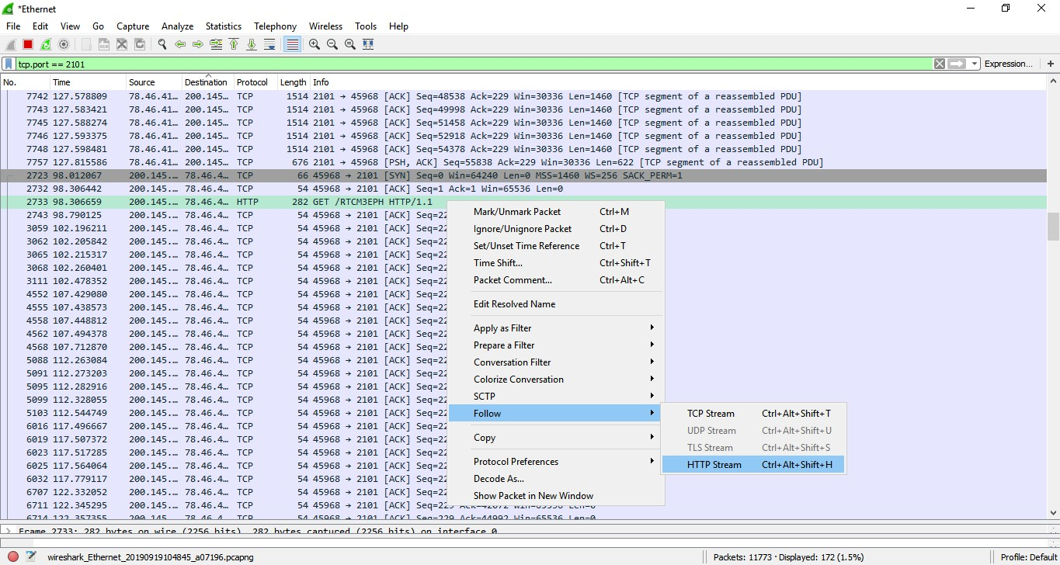
Wireshark – Follow Stream

Slide 14
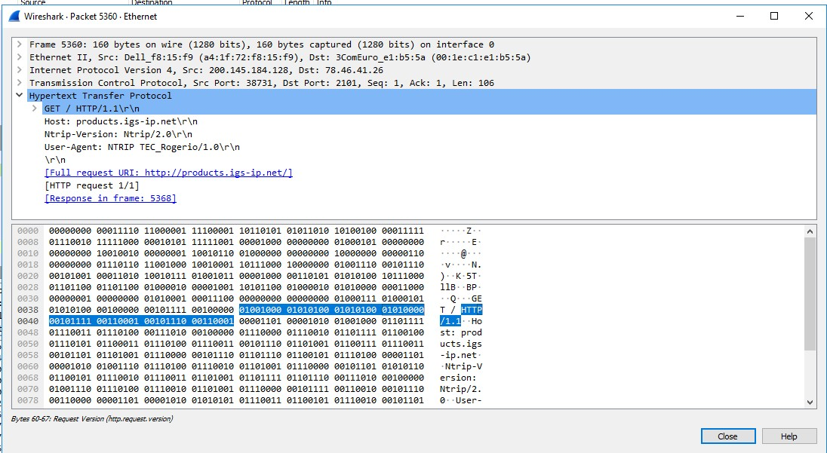
Wireshark – Ntrip
Sourcetable

Slide 15
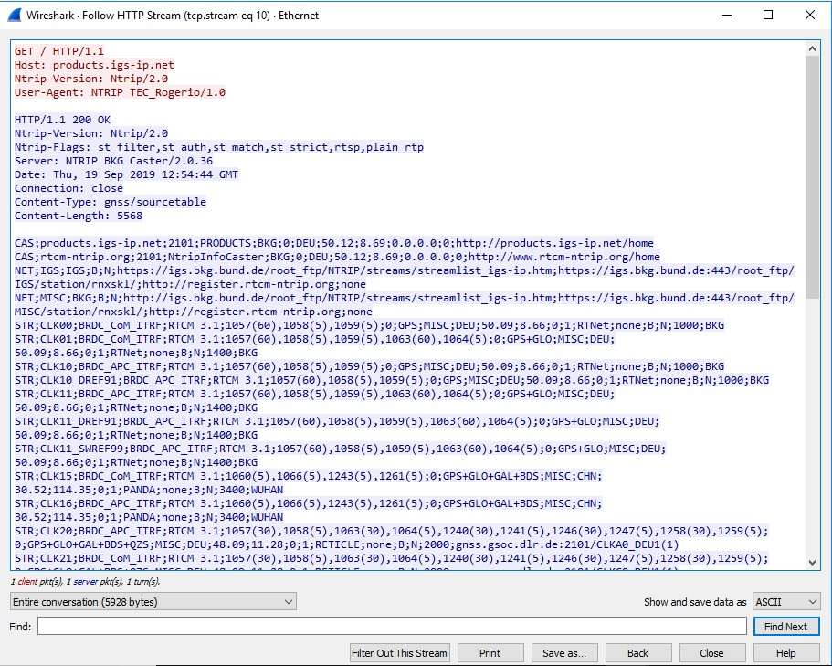
Wireshark – Ntrip
Sourcetable – HTTP Stream

Slide 16
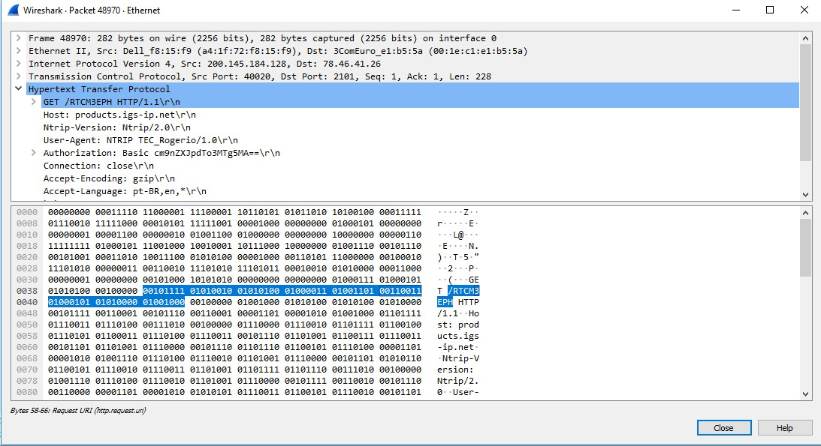
Wireshark – Ntrip
Mountpoint

Slide 17
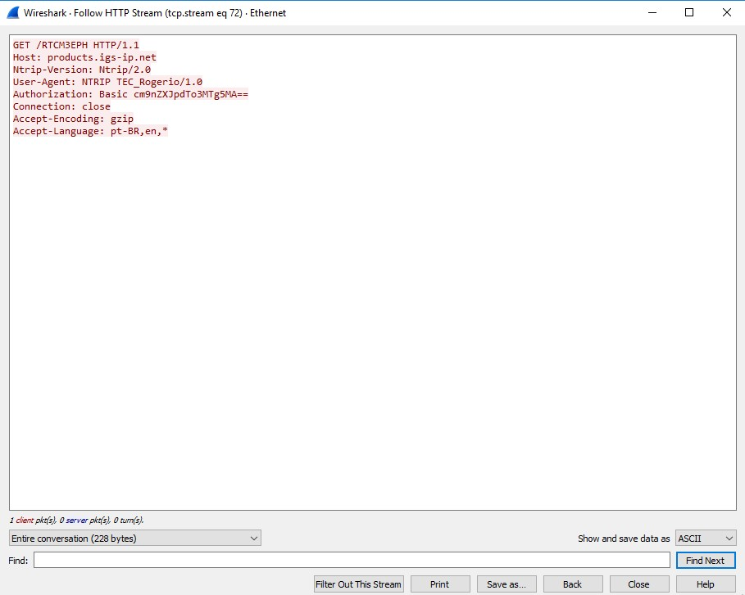
Wireshark – Ntrip
Mountpoint – HTTP Stream

Slide 18
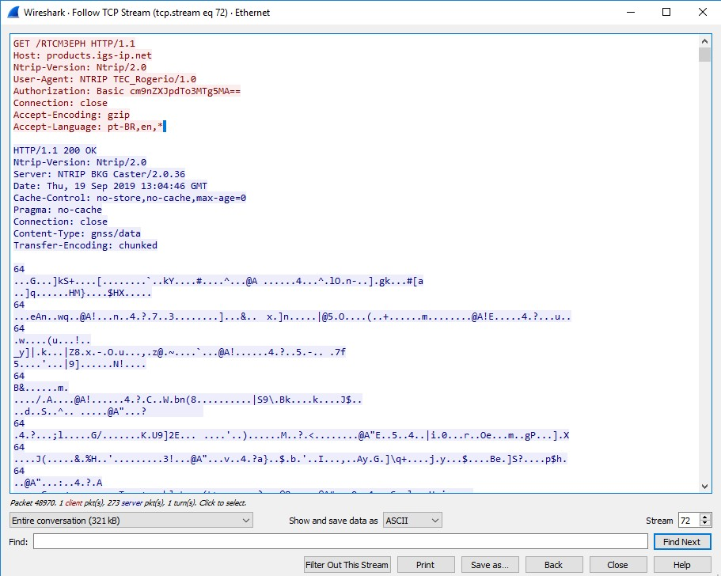
Wireshark – Ntrip
Mountpoint – TCP Stream

Slide 19
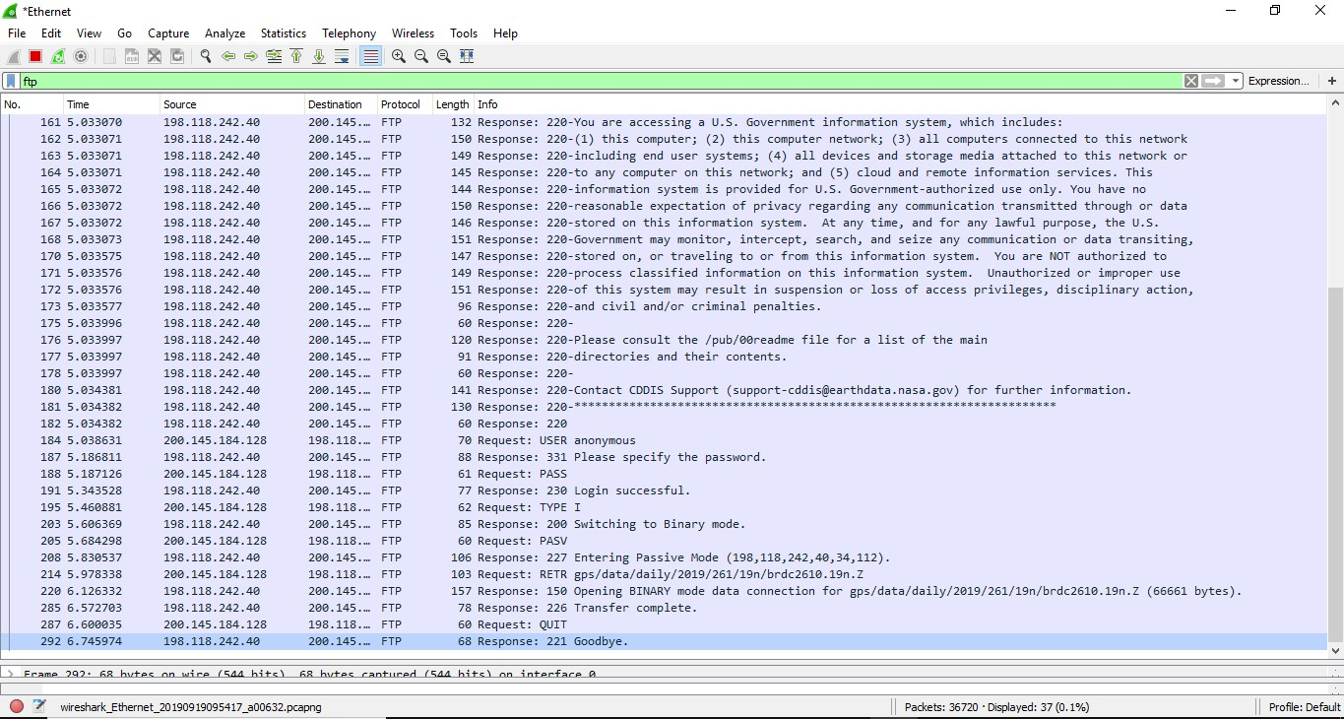
Wireshark – FTP
Get ephemeris from FTP Server

Slide 20
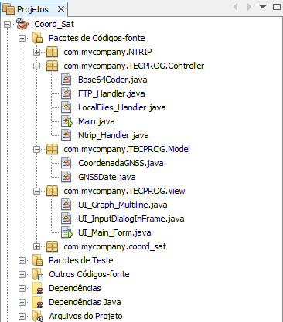
Maven Java Program

